Slide 1
AUTOMATED Water Tank Monitoring System
CSE 326 Section 3
Instructor: Razia Sultana
Lecturer at Engineering & Technology
Eastern University
Group members: Syed Foyez Uddin 181400106
Md. Kamrul Hassan 193400002
Abdullah-Al-Masum 193400003
Mirza Alamin Hossen 193400037
Notes:
We designed this template so that each member of the project team has a set of slides with its own theme. Members, here’s how you add a new slide to just your set:
Mark where you want to add the slide: Select an existing one in the Thumbnails pane, click the New Slide button, then choose a layout. The new slide gets the same theme as the other slides in your set.
Careful! Don’t annoy your fellow presenters by accidentally changing their themes. That can happen if you choose a different theme from the Design tab, which changes all of the slides in the presentation to that look.

Slide 2
Summary
Project aim
Objective
Features
Expected Impact
Demonstration/Showcase

Slide 3
Project Aim
Automation of water tank management

Slide 4
Objective
Cut down on employment cost
Reduction of management cost
Increase management efficiency/accuracy through automation

Slide 5
Features
Fluid level detection and control
Audio visual queue

Slide 6
Expected Impact
Industries
Consumers
Increased production rate
Management cost reduction
Employment cost reduction
Ease of Use
Convenience

Slide 7
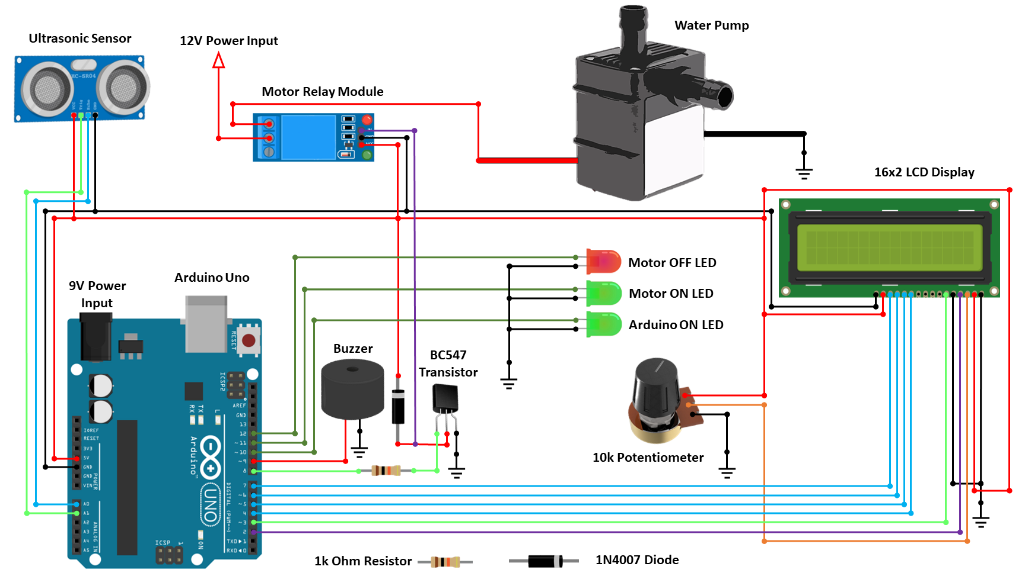
Demonstration/Showcase
Circuit Diagram

Slide 8
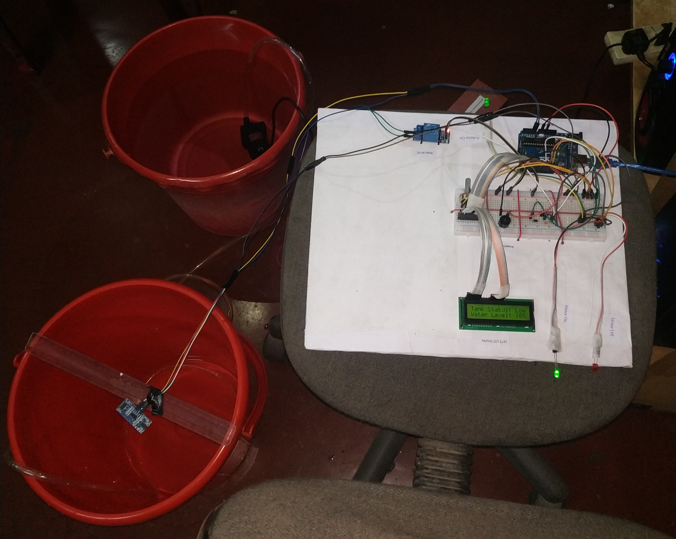
Demonstration/Showcase
Full Setup

Slide 9
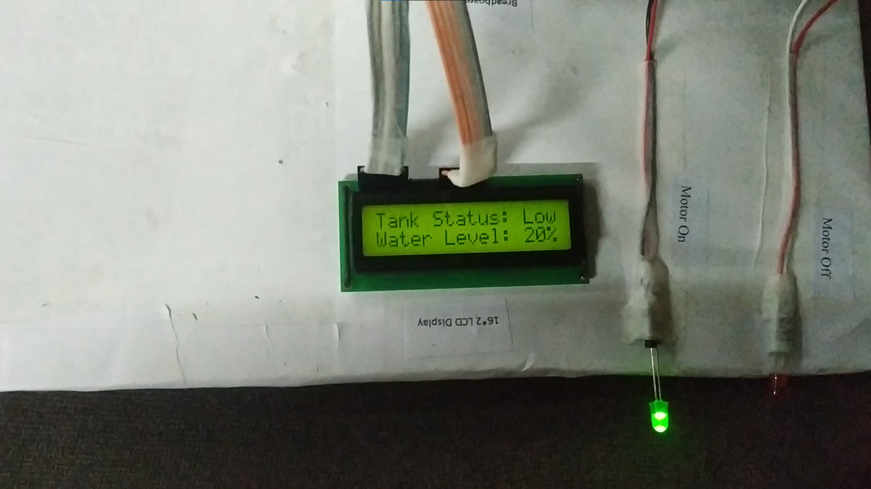
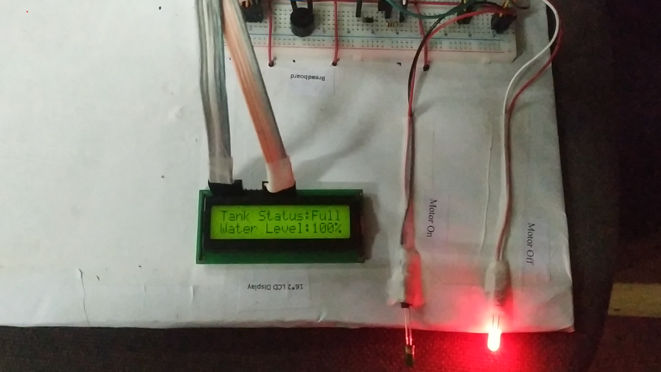
Demonstration/Showcase
‘Motor Status: On’
‘Motor Status: Off’

Slide 10
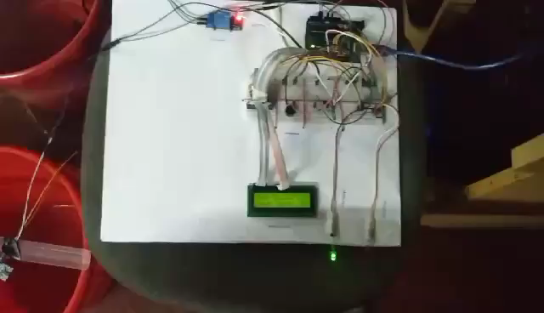
Demonstration/Showcase
Project in Work

Slide 11
Thank You

